Slide 1


Resync - Reports
Srivatsan Madapuzi Srinivasan
SMU | MITB

Slide 2
Table of Contents
Feature Overview
Market Research
Assumptions
Communication with members
Timeline of events
Team Details

Slide 3
Feature Overview
A new feature “reports” to be added to the existing Resync website.
A new web page in the Resync website where the following reports can be viewed,
Reports for the current year.
Reports for the previous years.
Request customized report
A microservice that generates a 6-page pdf file report and save in the local system.

Slide 4
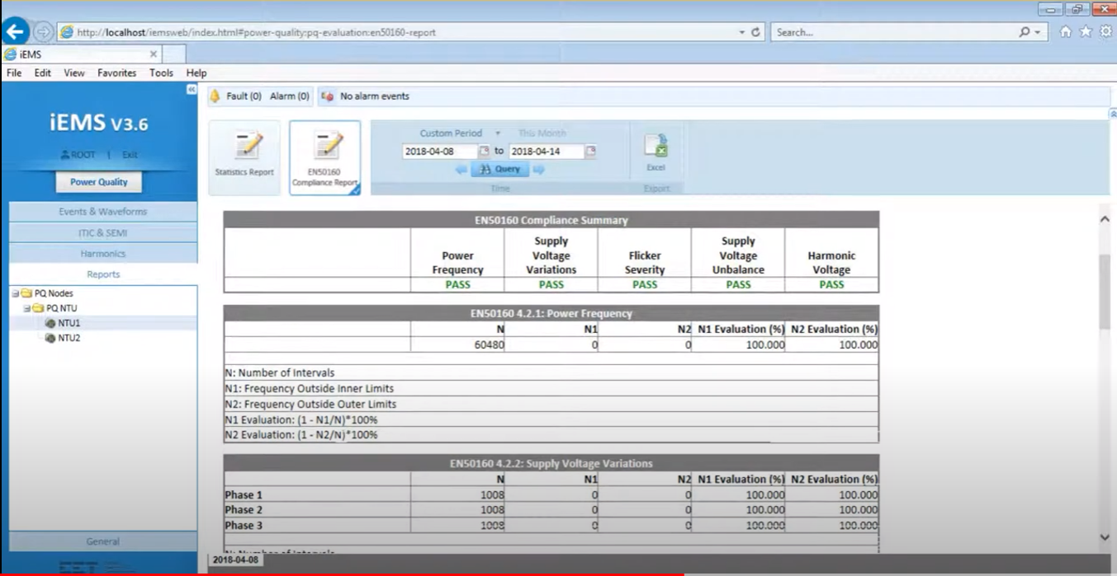

Market Research
Details about the competitors’ product’s report feature,
EcoXplore
Sensor Flow
Schneider Electric

Slide 5
Assumptions – Report Features
The following time series data can be included in the report,
Overall Energy Consumption
Occupancy Data
Highest Equipment Consumption data
HVAC control system efficiency
Carbon footprint emission

Slide 6
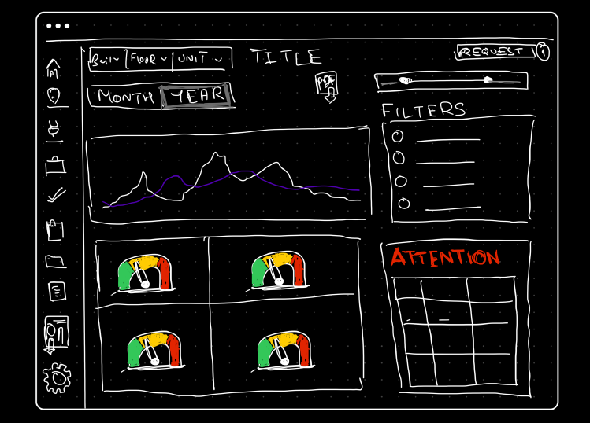
Assumption (..contd)
Low-Fidelity Prototype – Web Page

Slide 7

Product Team Details
Product Manager
Data Scientists - 2
UI/UX Designer - 1
Cloud Engineer - 1
Software Engineers
Frontend – 1
Backend – 1
Full-stack - 1

Slide 8
Communication – Collaboration
Communication
Construct user stories
User story pointing – Complexity and Importance
Daily catchups to understand the progress
Steps:
UI/UX Designer & Data Scientist Team – Data Visualization (5 days)
Data Scientists & Cloud Engineer – Data collection & Microservice (14 days)
Cloud Engineer – Measure performance of the System (Throughout the phase)
Full stack & Backend Engineer – API to use the microservice (14 days) (**Careful Collaboration)
Frontend & Full Stack Engineer – UI for web page (5 days)
PM & available team – Testing (8 days)

Slide 9
Measures of Success
User Engagement – Frequency of the feature being accessed
Client satisfaction
Improved benefits for clients
Efficient consumption
Cost cutting in energy consumed
Data Accuracy
System Performance

Slide 10

THANK YOU

